Slide 1
Intelligent Workflow Manager
Hackathon
Oct 2026

Slide 2
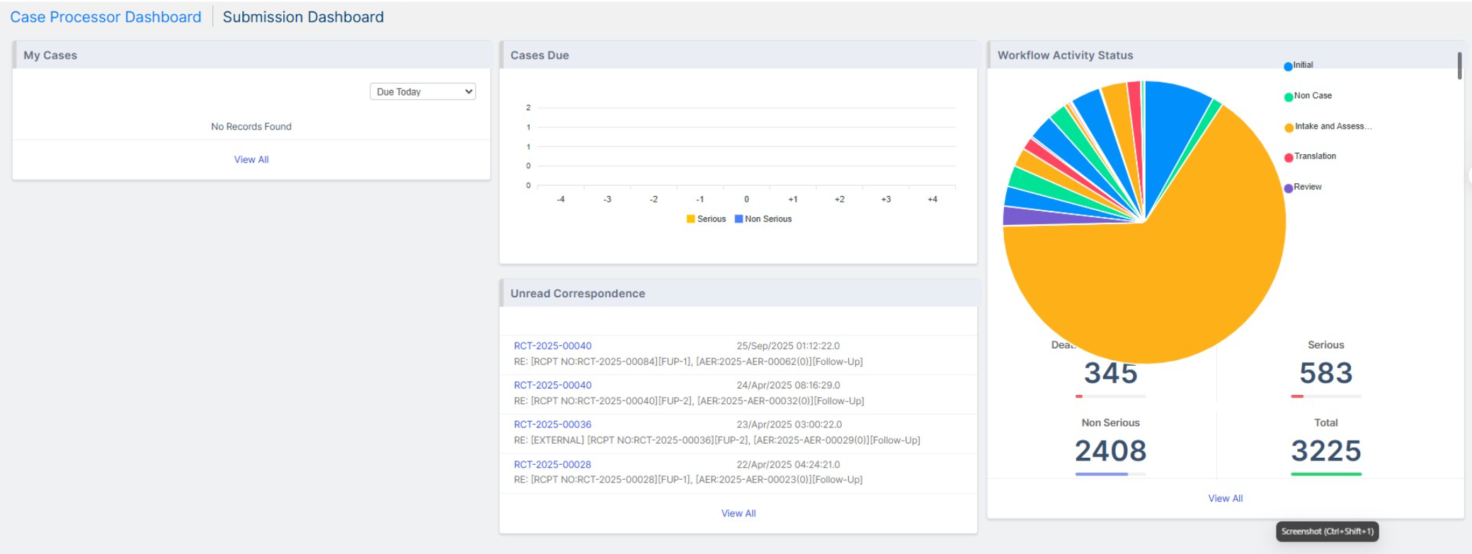
EXISTING CASE PROCESSOR DASHBOARD

Slide 3
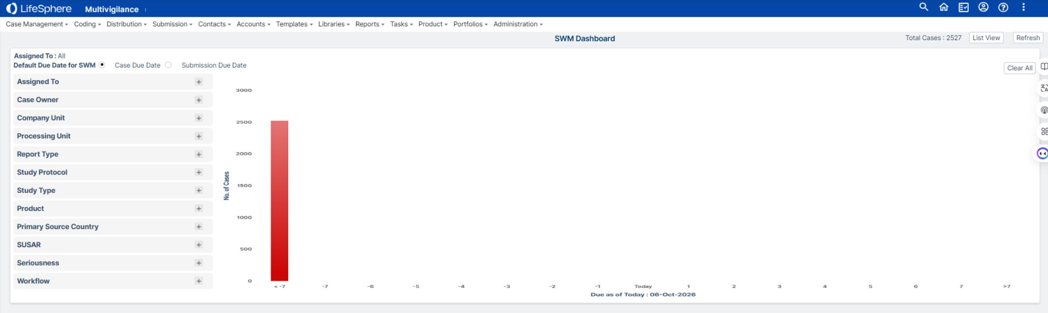
EXISTING SMART WORKFLOW DASHBOARD

Slide 4
INTELLIGENT WORKFLOW MANAGER
What a PV Operations Manager should see when they open the solution
WORKFLOW HEALTH
REGULATORY RISK
SLA RISK
BOTTLENECKS
WORKLOAD
92%
Healthy
12
Cases at risk
8
Predicted breaches
3
Need attention
2
Teams overloaded
PRIORITY ITEMS
AI RECOMMENDED ACTIONS
12 cases
High risk of missing reporting deadline
1
Prioritize 12 high-risk cases
2
Reassign 3 Medical Review cases
5 cases
Delayed in Medical Review
3
Review Person A's workload
Person A
125% workload capacity
4
Monitor 3 aging activities
3 cases
Stuck longer than historical norm
Human approval required for actions

Slide 5
FROM DASHBOARD TO ROOT CAUSE
Move from a risk signal to the exact reason and recommended action
Dashboard → Regulatory Risk → Medical Review → Case 123456 → Activity
CASE 123456 — HIGH RISK
AI EXPLANATION & NEXT BEST ACTION
Reporting due
14-Oct-2026
Risk reason
Current activity
Medical Review
“This case is likely to miss its reporting deadline because Medical Review is significantly slower than the historical baseline.”
Aging
6.2 days
Historical norm
2.5 days
Recommended action
Prioritize or reassign Medical Review
WHY IS IT AT RISK?
Medical Review aging is 2.5× historical norm and the reporting deadline is approaching.
Supporting evidence
Historical turnaround • current aging • due date • reviewer workload • case complexity
Explainable • Auditable • Human-controlled

Slide 6
THE IDEAL AGENTIC EXPERIENCE
Managers can ask questions in natural language instead of searching through multiple reports
ASK THE WORKFLOW MANAGER
Which cases are most likely to miss their regulatory deadline?
I found 12 high-risk cases. The main drivers are:
• 5 cases delayed in Medical Review • 4 cases with limited remaining time • 3 cases with unusual workflow aging
Why is Medical Review a bottleneck today?
AI identifies the cause, shows the supporting data, and suggests practical actions — without making the decision for the manager.

Slide 7
WHAT “GOOD” LOOKS LIKE
The solution should be proactive, explainable and useful in the manager’s daily work
SEE
PREDICT
EXPLAIN
One view of overall workflow health and priority risks
Identify regulatory and SLA risks before they become overdue
Clearly show why a case, team or activity is at risk
ACT
DRILL DOWN
CONTROL
Recommend the next best action — prioritize, reassign, escalate or monitor
Move from dashboard → team → case → activity
Keep AI recommendations explainable, auditable and human-controlled
What happened? → What is happening? → What will likely happen? → What should I do?

